Slide 1
Alignment procedure for SPCM
Morgan Blevins
Aug 30, 2024

Slide 2
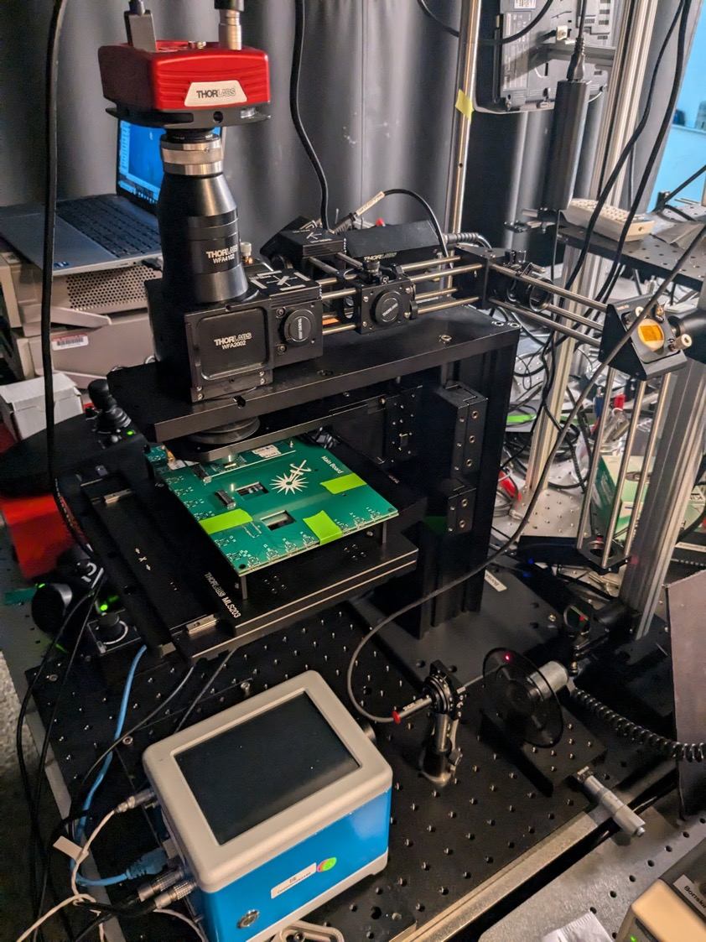
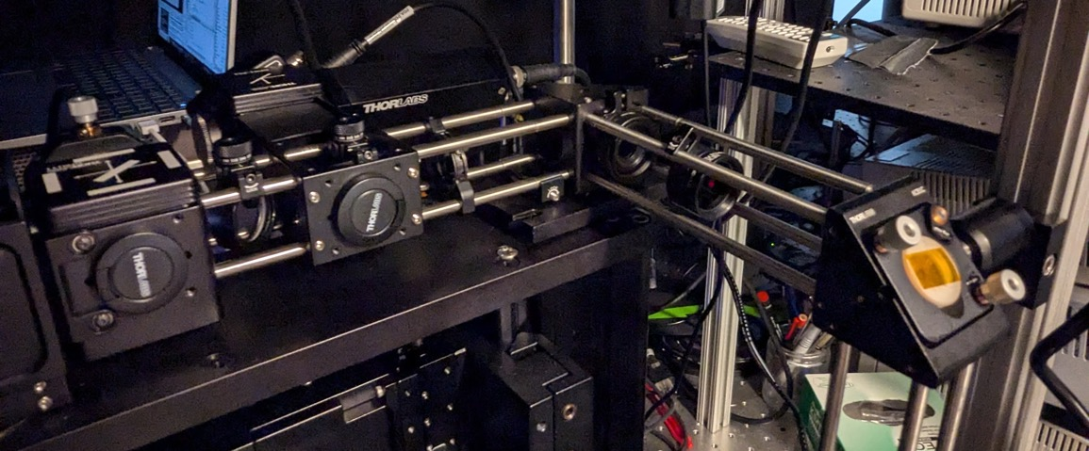
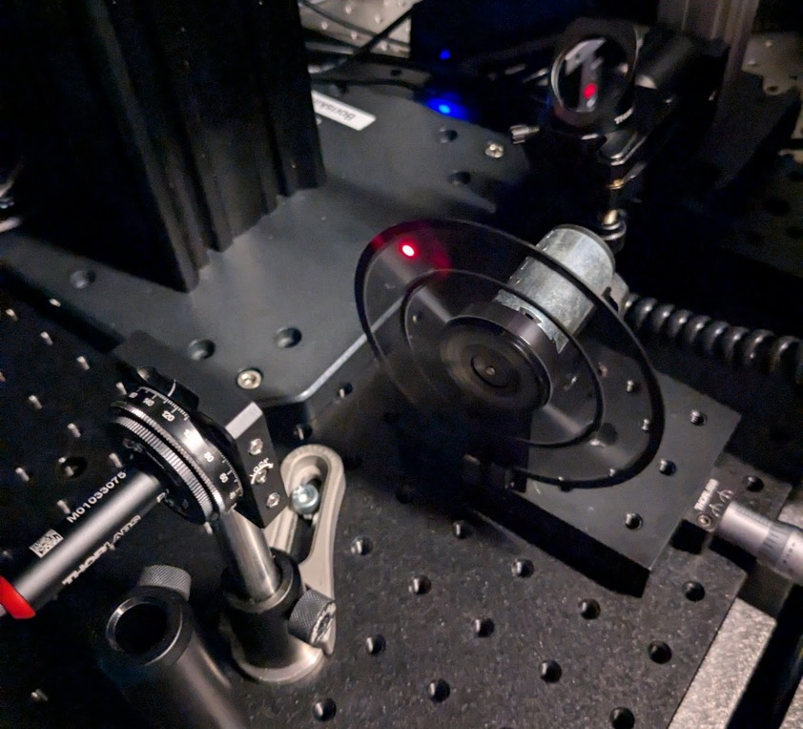
Beam compensator
iris
Mirror #3
Beam compensator
Mirror #3
iris
iris
Mirror #2
Beam splitter
ND filter
iris
Mirror #2
Beam splitter
Objective
Mirror #1
Chopper
Laser w/ 2-axis adjustable mount
Chopper
Laser w/ 2-axis adjustable mount

Slide 3
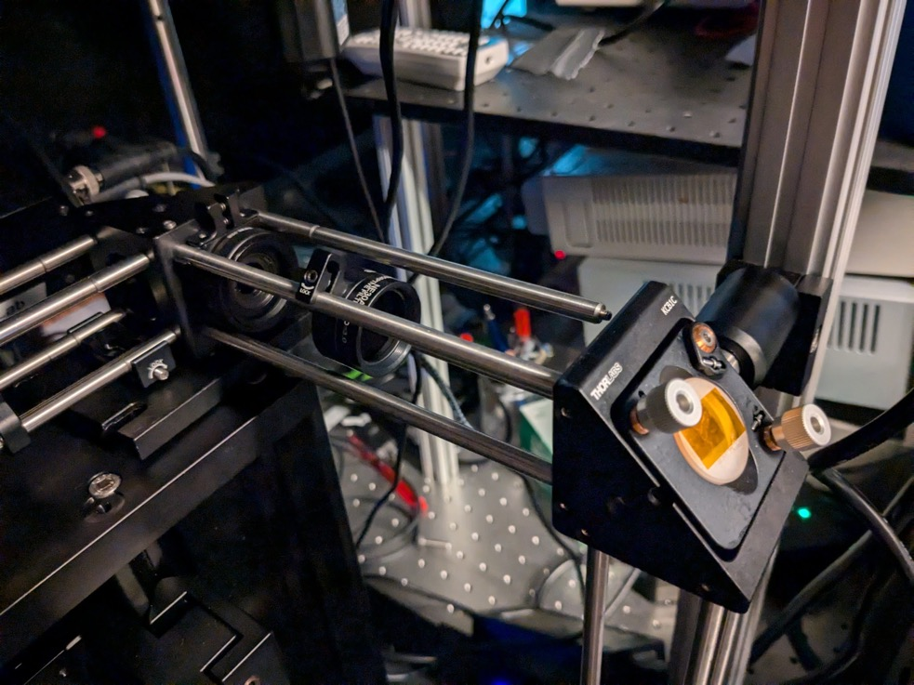
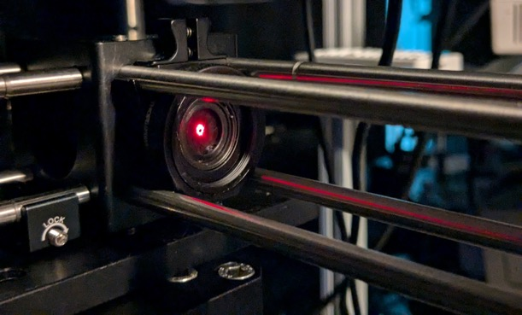
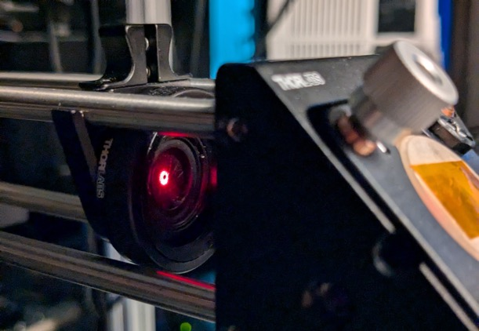
Note: I had to be pretty careful about how I locked down the mirror #2 to the vertical post. If its too high or low it bends the posts and make the system un-level.
Step 1
Adjust mirror #1 and #2 (or #1 and the laser holder) back and forth until the laser is aligned all along the cage section when the iris is moved back and forth
Mirror #2

Slide 4
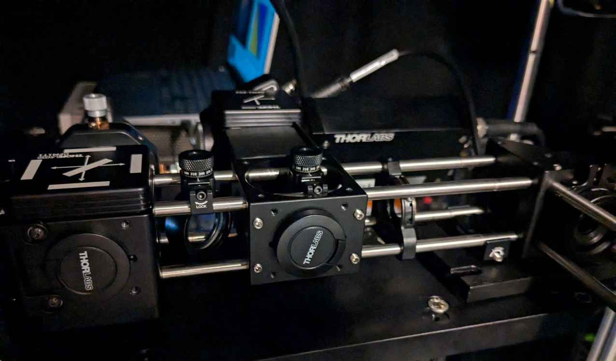
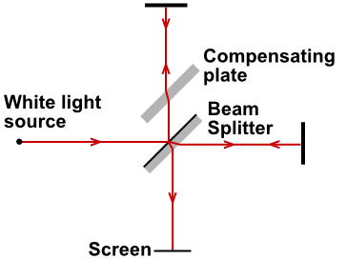
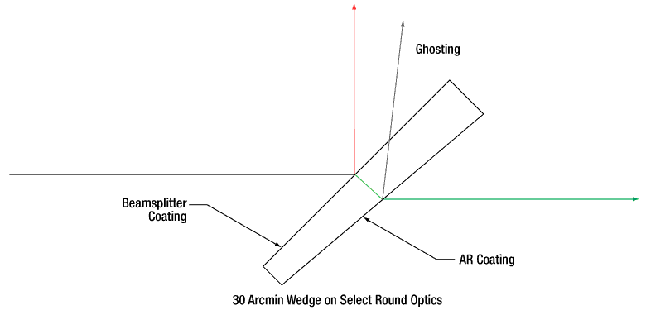
Can also monitor the beam profile on the camera and see that is centered
Step 2
Adjust mirror #3 until the laser is centered in the iris
Iris
Can also place a handing alignment marker here
Beam compensator is playing an important role in maintaining alignment to the objective.

Slide 5
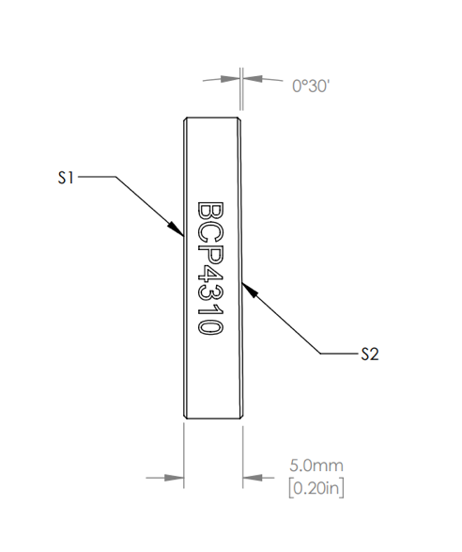
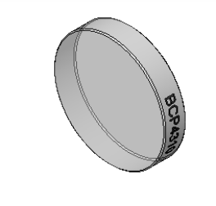
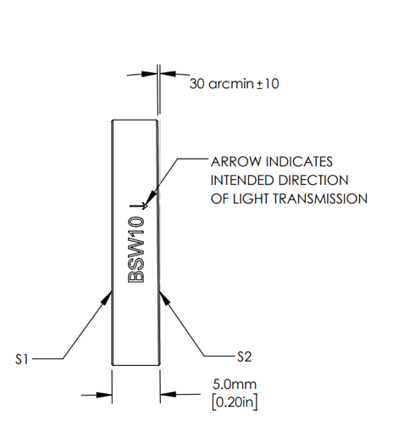
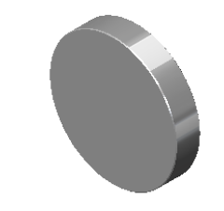
Beam compensation must be properly aligned to the optical path and the beamsplitter
The wedge angle has a certain orientation
There is a marker showing the top of the compensator
The beamsplitter also has a marker showing the top

Slide 6
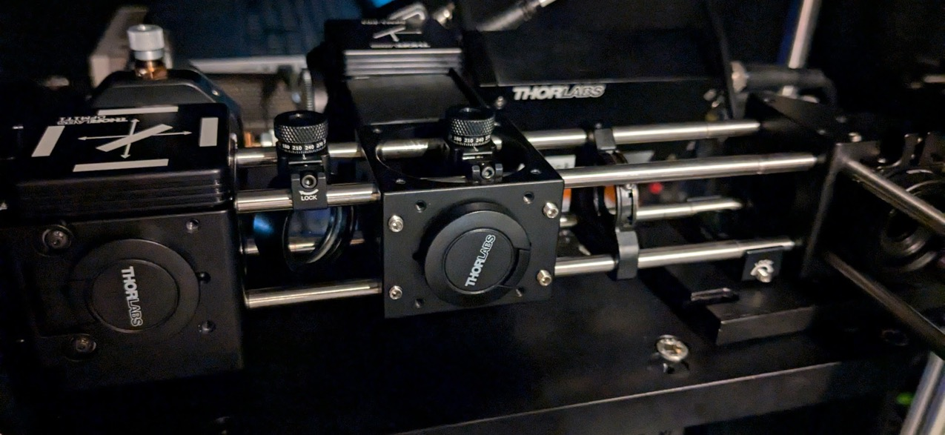
NOTE I’ve used a mounting base to tilt up the cage so it’s level.
I used the level app on my phone
In the future this should be done more exactly/precisely- should consult Thorlabs for best practice on this.
Mounting block

